Slide 1





MIDDLECHASE
Claim Your City…
0817.873.5450
About Middlechase
Our Estates
Featured Projects
Visit Our Site
Downloads
Login
Signup
www.homes.middlechase.com
BUY LAND
BUY HOME
BOOK INSPECTION
www.lands.middlechase.com
Name
Phone Number
Email
1
2
3
4
5
6
Interested Estate
Inspection Date
Preferred Time
Submit

Slide 2
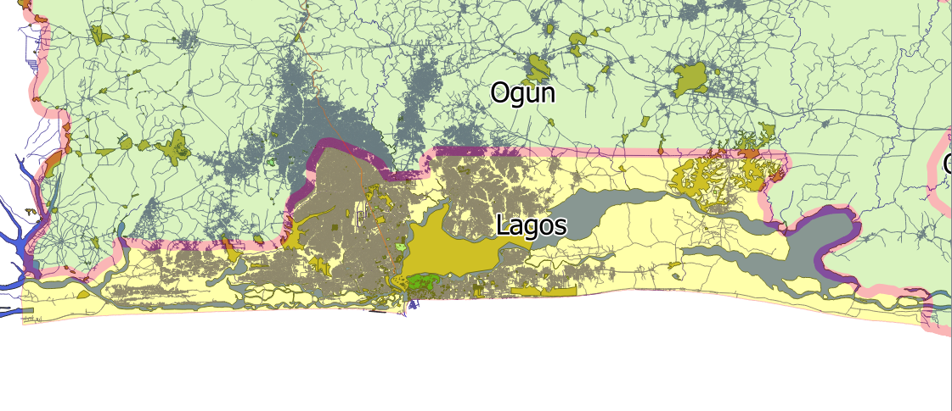









MIDDLECHASE
Claim Your City…
0817.873.5450
About Middlechase
Our Estates
Featured Projects
Visit Our Site
Downloads
IJEBU-ODE
IBAFO
OTA
AREPO
Login
Signup
IKEJA
IMOTA
ATAN
IKORODU
EPE
IGBESA
AGBARA
ELERANGBE
ABIJO
LAGOS-ISLAND
AJAH
BADAGRY
AKODO
SELECT ESTATE
BOOK SITE INSPECTION

Slide 3
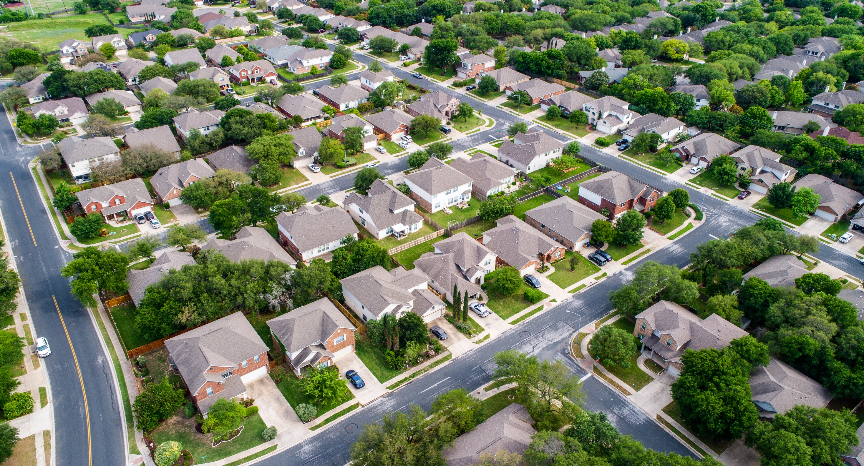




About MIDDLECHASE
Our Vision
Our Mission
Our Team
Property Baron
Claim Your Property Today
One of the most well-established companies in the real estate industry, Middlechase Property Limited provides families and investors with opportunities to invest in handpicked Nigerian property investments in today's top performing asset classes ranging from residential to commercial to mixed-use developments.
As the company has grown, markets have changed and MIDDLECHASE is the leading rental income developer in Africa dedicated to non-traditional residential development, innovatively designed to meet the needs of today’s astute investor and modern family.
Middlechase… Everyday Cashflow
359
CLIENTS
10,000
HOMES
4
COMMUNITIES
4,576
SITE VISITORS
The Fastest Growing Industry Leader In Rental Property Sales In Nigeria…

Slide 4
About MIDDLECHASE?
Our Vision
Our Mission
Our Team
Property Baron
Our Vision
As the leading inventor of excellently crafted community and recognised industry leader in asset development and management as MIDDLECHASE is to make first-time home buyers comfortable, happy and worry-free both during the home buying process and even after their closings and to be reputable Real Estate Sales Consultant for first-time home buyers and rental-income property, effectively eliminating competition within the market.
359
CLIENTS
10,000
HOMES
4
COMMUNITIES
4,576
SITE VISITORS
The Fastest Growing Industry Leader In Rental Property Sales In Nigeria…

Slide 5
About MIDDLECHASE?
Our Vision
Our Mission
Our Team
Property Baron
For those who want CONSISTENT INCOME, Middlechase provides instant access to rental income property ownership with the power to choose your preference.
To bridge the obvious gap between you and your dream of owing a home or consistently generating rental income from real estate which is a foolproof CashFlow and guaranteed system to help our clients hedge against inflation
359
CLIENTS
10,000
HOMES
4
COMMUNITIES
4,576
SITE VISITORS
The Fastest Growing Industry Leader In Rental Property Sales In Nigeria…

Slide 6




About MIDDLECHASE?
Our Vision
Our Mission
Our Team
Property Baron
Head of Sales
Sales Officer
Sales Officer
Sales Officer
Change On Mouse Over
Esther
OKENWA
Email
esther@middlechase.com
Phone
0706 212 4157
Ayooluwa
OLANIYI
Email
ayo@middlechase.com
Phone
0818 657 7704
Oyeyemi
ODEYEMI
Email
yemi@middlechase.com
Phone
0700 000 0000
Mirabel
ABUBA
Email
mirabel@middlechase.com
Phone
0700 000 0000
359
CLIENTS
10,000
HOMES
4
COMMUNITIES
4,576
SITE VISITORS
The Fastest Growing Industry Leader In Rental Property Sales In Nigeria…
Head of Sales
Sales Officer
Sales Officer
Sales Officer

Slide 7

About MIDDLECHASE?
Our Vision
Our Mission
Our Team
Property Baron
Earn As Much As 20% When You Refer Us To A Land Buyer!
Property Baron Network, an opportunity yet untapped is our investment program designed for our customers and realtors that want to build CashFlow.
Join PROPERTY BARON NETWORK Powered by Arkbridge Integrated Limited as our way to ‘Make Your Network Your Net Worth’ The process is transparent, accessible and informative.
Partner With Us As A Realtor Today And Enjoy The Benefits Of CashFlow and Rental Income
Join Network Now
www.pbn.arkbridge.com.ng
Benefits Of Buying Into Our Development
There is one unique features with our estate projects which we would guarantee you when you buy into any of them. We do not just sell land we sell serene experience that is affordable. We pride ourselves as Africa’s leading inventor of excellently crafted Communities

Slide 8











Our Estate Features
Paved Road Network
CCTV Services
Recreation Centre
Sports Court/ Pitch
Electricity
Waste Management System
Good Drainage Network
Estate Clinic
Uniformed Security Operatives
24-7 Estate Admin Office
Perimeter Fence

Slide 9
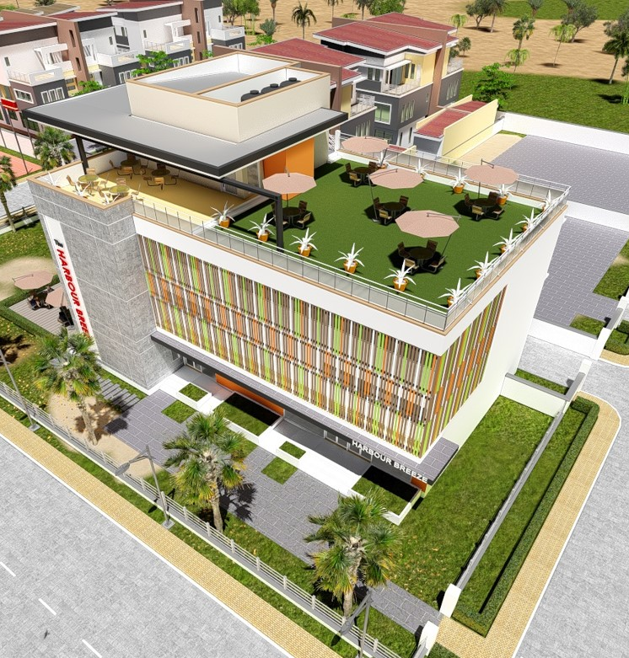
Our ESTATE
Income Comes First…
Africa's Inventor of Excellently Crafted Communities
Bespoke developments
Highly desirable locations
First-class service
Innovative investment solutions
Middlechase is an award winning international property developer, specializing in emerging property income markets and is currently pioneering niche and iconic projects in Nigeria and Africa.
The company has a proud history of over 9 years' experience and success, and continues to produce and develop bespoke property investments in some of the Nigeria's most desirable locations.
With its expertise in emerging property income markets, Middlechase has recognized the unparalleled investment opportunities in Nigeria and Africa, and is proud to offer clients innovative off-plan properties in these sought-after regions, as well as unrivalled investment services and pioneering products.
With a passion for excellence and a commitment to affordable luxury development in all areas of construction, design, finish and service, Middlechase is leading the way for innovative and affordable property development in Lagos, Port-Harcourt, Calabar, Abuja etc., providing its clients with luxury properties for a secure and profitable investment

Slide 10
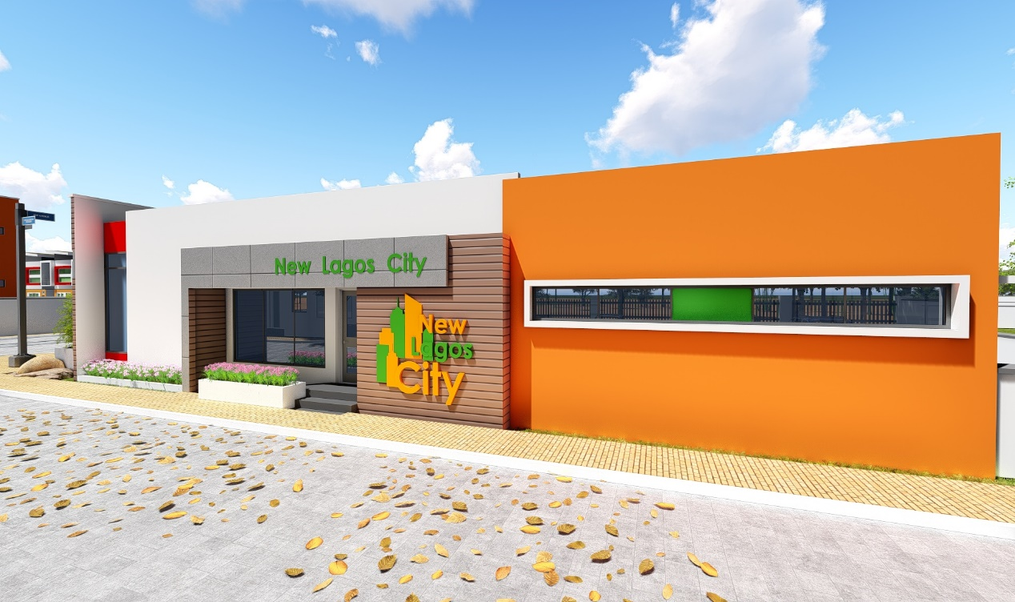
01
New Lagos City
Estate
Wonderful Lakeside Living…
The New Lagos City is a residential estate development project powered by Arkbridge Integrated limited through Middlechase Property LLC. The project sits on about 20acres of land in Abijo, a small town just less than 5 minutes from Sangotedo and about 15 minutes from Ajah, off the Lekki-epe express way in Ibeju-Lekki. This estate project offers home buyers an opportunity to have a taste of luxury yet affordable and also creates a wealth portfolio for those with keen interest in Real Estate Investment.
Victoria-Island
15 min | 12.5KM
Abijo
3 min | 3.2KM
Eleko Junction
Ajah
Awoyaya
35 min | 27.6KM
20 min |18.8KM
Learn More
Estate Layout

Slide 11
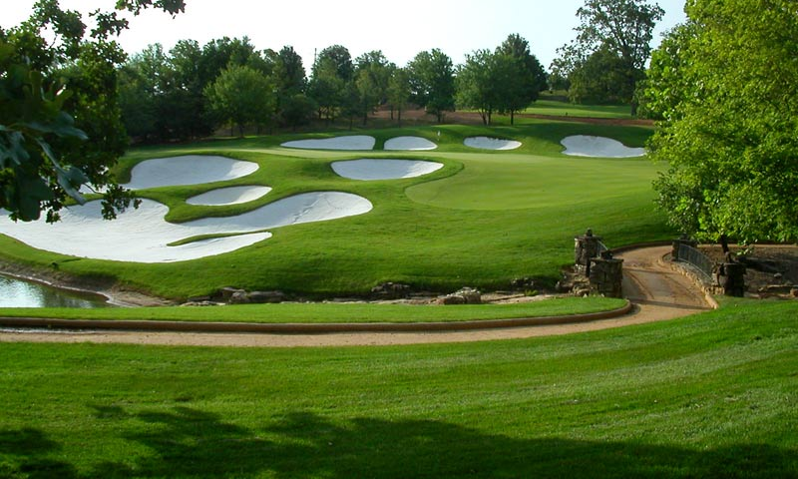
02
Eastland Golf
Estate
In Lush Serenity…
Eastland Golf Estate is a 30 acre estate development of Middlechase Property Limited located in Abijo, Ibeju-Lekki which would be sold in plots to early property buyers and subsequently serves as a residential development for first-time home-owners.
The estate would feature 4 acres of Nigeria’s first family golf course and recreational facility to ease resident and provide luxury comfort including a state-of-the-art meeting space, ballroom, which provides the Estate with a significant competitive advantage. The Property has the first Family Golf Course in Nigeria, allowing it to capture a substantial share of the corporate and social business. In addition, the Property contains two recreational facility, an outdoor swimming pool, outdoor hot tub, two fitness facilities, a business center, and covered parking.
Victoria-Island
15 min | 12.5KM
Abijo
3 min | 3.2KM
Eleko Junction
Ajah
Awoyaya
35 min | 27.6KM
20 min |18.8KM
Estate Layout
Learn More

Slide 12
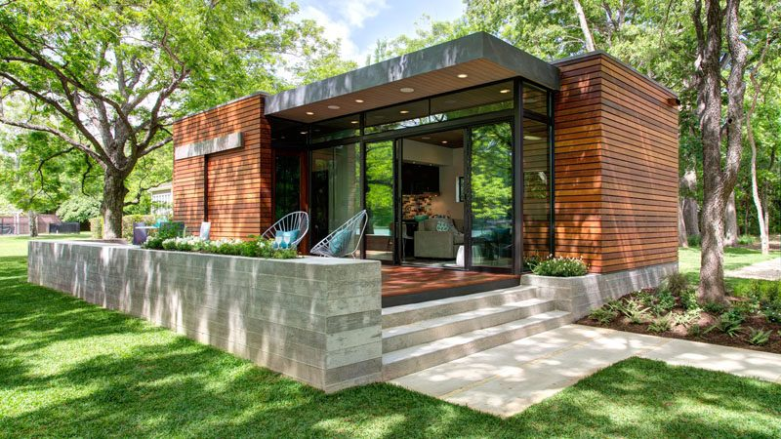
03
Dream Parks & Garden Estate
Serene Beachside Splendor…
Located in Orofun-Akodo, just a few minutes before the Free Trade Zone and 30 minutes from Ajah. The property has a Supreme Court judgment and would also serve as the site for private golf course and a Cancer Therapy Centre, which would be the first centre to offer affordable services to the public.
Ajah
18 min | 11.8KM
Orofun-Akodo
5 min | 3.4KM
Dangote Refinery
Eleko Junction
Lekki FTZ
58 min | 43.3KM
20 min |14.7KM
Learn More
Estate Layout

Slide 13
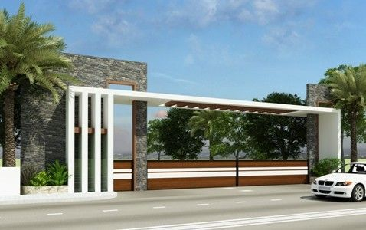
04
Easthampton
Estate
Above And Beyond Tranquility…
Located in Elerangbe, the site is just a stone throw to the proposed Lekki International Airport, and would serve as an income producing asset for investors who would like to position themselves for developers partnership to build apartment units because of the proximity of the property to the airport.
Ajah
15 min | 12.5KM
Elerangbe
3 min | 3.2KM
Epe
Eleko Junction
Lekki Airport
(Proposed Site)
35 min | 27.6KM
20 min |18.8KM
Estate Layout
Learn More

Slide 14

Featured Projects
Dream Parks & Gardens Estate
Choose A Plot Now
Location Map
Located in Orofun-Akodo, just a few minutes before the Free Trade Zone and 30 minutes from Ajah. The property has a Supreme Court judgment and would also serve as the site for private golf course and a Cancer Therapy Centre, which would be the first centre to offer affordable services to the public.
Title –
Supreme Court
Judgement
Documentation –
Contract of Sale (Before Payment Completion) | Payment Receipt | Allocation Letter | Deed of Estate Covenant | Provisional Survey
Maxi Lot 900m²
2 Plots - 100Ft X 100Ft (900m²)
₦9,000,000
Outright Payment
Midi Lot 450m²
12 Months
Instalment
₦750,000
24 Months
Instalment
₦375,000
36 Months
Instalment
₦250,000
156 Weeks
Instalment
₦57,700
Compact Lot 225m²
Subscribe Now

Slide 15
Featured Projects
Dream Parks & Gardens Estate
Choose A Plot Now
Location Map
Located in Orofun-Akodo, just a few minutes before the Free Trade Zone and 30 minutes from Ajah. The property has a Supreme Court judgment and would also serve as the site for private golf course and a Cancer Therapy Centre, which would be the first centre to offer affordable services to the public.
Title –
Supreme Court
Judgement
Documentation –
Contract of Sale (Before Payment Completion) | Payment Receipt | Allocation Letter | Deed of Estate Covenant | Provisional Survey
Maxi Lot 900m²
1 Plot - 50Ft X 100Ft (450m²)
₦4,800,000
Outright Payment
Midi Lot 450m²
12 Months
Instalment
₦400,000
24 Months
Instalment
₦200,000
36 Months
Instalment
₦135,000
156 Weeks
Instalment
₦30,770
Compact Lot 225m²
Subscribe Now

Slide 16
Featured Projects
Dream Parks & Gardens Estate
Choose A Plot Now
Location Map
Located in Orofun-Akodo, just a few minutes before the Free Trade Zone and 30 minutes from Ajah. The property has a Supreme Court judgment and would also serve as the site for private golf course and a Cancer Therapy Centre, which would be the first centre to offer affordable services to the public.
Title –
Supreme Court
Judgement
Documentation –
Contract of Sale (Before Payment Completion) | Payment Receipt | Allocation Letter | Deed of Estate Covenant | Provisional Survey
Maxi Lot 900m²
½ Plot - 25Ft X 100Ft (225m²)
₦2,700,000
Outright Payment
Midi Lot 450m²
12 Months
Instalment
₦225,000
24 Months
Instalment
₦112,500
36 Months
Instalment
₦75,000
156 Weeks
Instalment
₦17,310
Compact Lot 225m²
Subscribe Now

Slide 17

Featured Projects
Easthampton Estate
Choose A Plot Now
Location Map
Located in Elerangbe, the site is just a stone throw to the proposed Lekki International Airport, and would serve as an income producing asset for investors who would like to position themselves for developers partnership to build apartment units because of the proximity of the property to the airport.
Title –
Supreme Court
Judgement
Documentation –
Contract of Sale (Before Payment Completion) | Payment Receipt | Allocation Letter | Deed of Estate Covenant | Provisional Survey
Maxi Lot 900m²
2 Plots - 100Ft X 100Ft (900m²)
₦4,800,000
Outright Payment
Midi Lot 450m²
12 Months
Instalment
₦400,000
24 Months
Instalment
₦200,000
36 Months
Instalment
₦135,000
156 Weeks
Instalment
₦30,700
Compact Lot 225m²
Subscribe Now

Slide 18
Featured Projects
Easthampton Estate
Choose A Plot Now
Location Map
Located in Elerangbe, the site is just a stone throw to the proposed Lekki International Airport, and would serve as an income producing asset for investors who would like to position themselves for developers partnership to build apartment units because of the proximity of the property to the airport.
Title –
Supreme Court
Judgement
Documentation –
Contract of Sale (Before Payment Completion) | Payment Receipt | Allocation Letter | Deed of Estate Covenant | Provisional Survey
Maxi Lot 900m²
1 Plot - 50Ft X 100Ft (450m²)
₦2,700,000
Outright Payment
Midi Lot 450m²
12 Months
Instalment
₦225,000
24 Months
Instalment
₦112,500
36 Months
Instalment
₦75,000
156 Weeks
Instalment
₦17,310
Compact Lot 225m²
Subscribe Now

Slide 19
Featured Projects
Easthampton Estate
Choose A Plot Now
Location Map
Located in Elerangbe, the site is just a stone throw to the proposed Lekki International Airport, and would serve as an income producing asset for investors who would like to position themselves for developers partnership to build apartment units because of the proximity of the property to the airport.
Title –
Supreme Court
Judgement
Documentation –
Contract of Sale (Before Payment Completion) | Payment Receipt | Allocation Letter | Deed of Estate Covenant | Provisional Survey
Maxi Lot 900m²
2 Plots - 100Ft X 100Ft (900m²)
₦1,500,000
Outright Payment
Midi Lot 450m²
12 Months
Instalment
₦125,000
24 Months
Instalment
₦62,500
36 Months
Instalment
₦42,000
156 Weeks
Instalment
₦9,615
Compact Lot 225m²
Subscribe Now

Slide 20







Other Projects
New Lagos City Estate
Abijo, Lekki, Lagos State
Century Park Estate
Arepo, Ogun State
Millennium Garden City
Igbesa, Agbara, Ogun State
Freedom Park Estate
Atan-Agbara, Ogun State
BOOK A VISIT FOR FREE
Are You Considering A Site Inspection Or Office Visit
Request A Free Ride From Your Home Or Office To Our Office And Also To The Site For FREE
Book Now
Name
Phone Number
Email
1
2
3
4
5
6
Interested Estate
Inspection Date
Preferred Time
Submit

Slide 21
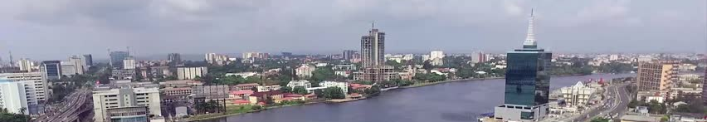
DOWNLOADS
Application Form | Project Schedule | Brochure | FAQ

